Slide 1
Web API
Chapter 17

Slide 2
Chapter Overview
Objectives
Understand the Web API framework
Learn how to create, test and document a Web API
Chapter Content
What is Web API
The HTTP Request, Response and Methods
Content Negotiation
Controllers
Data Transfer Objects
Using Postman
Open API/Swagger
Consuming the API
Exercise
Creating and calling Web API Services

Slide 3
What is Web API?
A RESTful Framework for building HTTP based services
REST – Representational State Transfer
Stateless – the server does not remember state in between calls
Each call includes the resource that is being acted on, and details of the action to be carried out
REST over HTTP
The URL represents the resource (the same URL is used for fetching, inserting, updating, deleting)
The HTTP verb indicates the action to take
Additional data is added in the request body
Basically APIs callable over HTTP
Highly interoperable with non Microsoft platforms
Efficient backend for all mobile clients

Slide 4


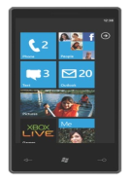










Any HTTP-Aware Client Can Connect
Fully interoperable
Web API
HTTP
Browsers
Devices
Phones
Tablets

Slide 5
The HTTP request
HTTP Method to execute
GET http://localhost:8602/api/values/5 HTTP/1.1
Accept: application/json, text/html, application/xhtml+xml
Accept-Language: en-US,en;q=0.5
Accept-Encoding: gzip, deflate
Host: localhost:8602
Request Headers
Request Body
Complex types passed here …
Format to return
Serialized types
(Models)
Notes:
The format of the request and response messages are similar, and English-oriented.
Both kinds of messages consist of:
An initial line,
Zero or more header lines,
A blank line (i.e. a CRLF by itself), and
An optional message body (e.g. a file, or query data, or query output).
<initial line>
Header1: value1
Header2: value2
Header3: value3
<optional message body goes here, like file contents or query data>

Slide 6
The HTTP Response
Returned Status Code
HTTP/1.1 200 OK
Cache-Control: no-cache
Pragma: no-cache
Content-Type: application/json; charset=utf-8
Expires: -1
Server: Microsoft-IIS/8.0
X-AspNet-Version: 4.0.30319
X-Powered-By: ASP.NET
Date: Wed, 23 Apr 2022 03:49:50 GMT
Content-Length: 10
“… complex types being returned …"
Response Headers
The format being returned
Response Body
Serialized types
(Models)

Slide 7
HTTP Methods
HTTP methods are mapped to method calls on the server
Key HTTP methods allow CRUD capability
GET
Read: get a list of entities, or a single entity
POST
Insert: creates a new entity
PUT
Update: updates the entity or entities
DELETE
Delete: deletes an entity
PATCH
Partial update: updates entities only when request attributes match
Notes:
While GET and POST are by far the most common methods that are used to access information provided by a web server, the Hypertext Transfer Protocol (HTTP) allows several other (and somewhat less known) methods. RFC 2616 (which describes HTTP version 1.1 which is the today standard) defines the following eight methods:
HEAD
GET
POST
PUT
DELETE
TRACE
OPTIONS
CONNECT

Slide 8
Status codes returned
Return values indicating success or failure
Or additional information
Code | Description | What it really means for a client of the Web API
200 | OK | It worked!
201 | Created | The resource was created OK!
304 | Not Modified | The client can use the cached version of this resource
400 | Bad Request | The client did something wrong.
401 | Not Authorized | The Web API is requesting the client to authenticate.
403 | Forbidden | The server is refusing due to client’s authorization.
404 | Not Found | The resource was not found.
500 | Internal Server Error | Something went bad on the server.
Notes:
Status codes describe the result of the server’s attempt to process the request. They are constructed from a three-digit integer and a description called a reason phrase. HTTP has five different categories of status codes:
1xx – Informational
2xx – Success
3xx – Redirection
4xx – Client Error
5xx – Server Error

Slide 9
Content Negotiation
The HTTP body can be in many different formats
Client and server agree on the format sent and returned
Known as the Media type
Is extensible to custom formats
Can be binary
JSON: {
“ID":"123“,
“Name”:”ASP.NET”
}
XML: <Course>
<ID>123</ID>
<Name>ASP.NET</Name>
</Course>
Other:
Images
HTML
CSV
Custom
...
Notes:
Content negotiation is a mechanism defined in the HTTP specification that makes it possible to serve different formats of the content at the same location, so that client applications can specify the type they need. One use of this mechanism is to serve data in Json or XML format. To summarize how this works, when a client application submits a request to a server, the request informs the server what formats it supports. More precisely, the client provides an Accept HTTP header that lists acceptable media types and associated quality factors. The server is then able to supply the resource in the format that best fits the user agent's needs.

Slide 10
Content Negotiation
HTTP Requests containing a body must specify the format
Content-Type: application/json; charset=utf-8
HTTP Requests use an Accept header to specify the return format
Accept: application/json, application/xml
Internet media types (MIME) are used to specify formats:
application/json
application/xhtml+xml
text/html
Notes:
Media types (sometimes called MIME types or content types) are a classification system used to identify files commonly found on Web sites. Media types are crucial to the functioning of the Web, because when a client computer makes a requests from a server, the client computer uses media types to inform the server what type of files the client computer can accept. Conversely, when the server sends data back to the client computer, the server uses media types to identify what type of data it is sending back. This information can be used by client to render or process the data it receives.
With Web API content negotiation, we can return data based on the client requests. What I mean is, if the client is requesting the data to be returned as JSON or XML, the Web API framework deals with the request type and returns the data appropriately based on the media type. By default Web API provides JSON and XML based responses.

Slide 11
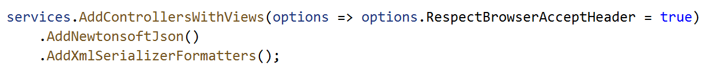
Media Type Formatters
By default, Web API:
Ignores the Accept header, and only returns plain text or JSON
Uses the System.Text.Json namespace for serialisation
Can be configured . For example you can:
Add new media types such as XML, by adding a suitable media type formatter
Use alternative formatters, e.g. Newtonsoft.Json for JSON, which supports a wider range of features
In a project that combines MVC and Web API controllers:
use services.AddControllersWithViews() to customize media type formatting
In a project that only contains Web API controllers:
use services.AddControllers() to customize media type formatting
Notes:
Note that, in order to use the .AddNewtonsoftJson() method shown on the slide, you need to add the following Nuget package first:
Microsoft.AspNetCore.Mvc.NewtonsoftJson

Slide 12
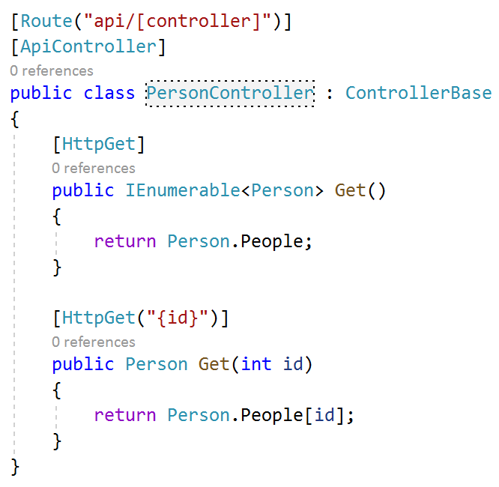
Web API Controllers
Controllers:
Must inherit from ControllerBase
The Controller class, which inherits from ControllerBase, contains features specific to MVC controllers
For controllers that only contain Web API actions, it is recommended to inherit directly from ControlerBase
Normally use attribute routing
Controller attribute indicates the URL prefix for the resource
Action attributes indicate the verb the action responds to, and anything that follows the prefix in the URL
By convention the route begins with “api/”
Note: [controller] within the route. [ ] is an alternative to { }
Notes:
Unlike previous versions of Web API, the name of the action method is no longer used to create routing conventions. Instead, verb attributes must be added to the methods.
The verb attributes specify anything to be added onto the controller’s route prefix, for example an ID which is bound to the action’s parameter.

Slide 13
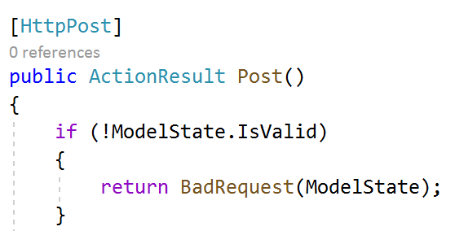
The [ApiController] attibute
The [ApiController] is not required
But it is recommended, because it changes the behaviour of the controller in ways that are normally desired in Web API
It prevents conventional routing from being used to reach the controller
It is normal that attribute routing is used for Web API controllers
It automatically checks the model state, and returns an error if the model is invalid
Equivalent of adding this into every action:

Slide 14
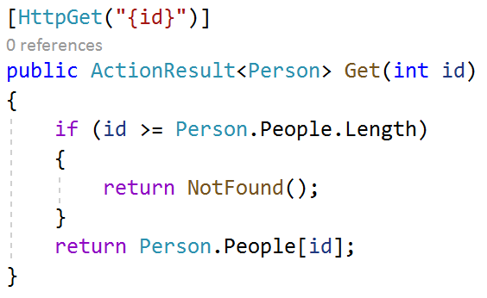
Action Return Types
With the default media type formatters configured, based on the return type of your action:
Fundamental types, and some other types such as DateTime, are returned to browser as plain text
Most other types, e.g. application classes, are serialised as JSON
You can get more control over the response by returning an ActionResult<TValue>
Enables you to specify the status code to be sent to the browser

Slide 15
More About ActionResult
When your method’s return type is ActionResult, you can return:
Any class that inherits from ActionResult. Common examples are:
NotFoundResult (status code 404)
BadRequestResult (status code 400)
OkResult (status code 200)
OkObjectResult (status code 200, and also returns a serialised object)
You can create these objects yourself, but it’s usually more convenient to use helper methods to create them:
NotFound() returns a NotFoundResult
BadRequest() returns a BadRequestResult
return result; is a shortcut for return Ok(result);
This shortcut is not available when the data type of the variable being returned is an interface

Slide 16
Data Transfer Objects
It is possible to use Web API to serialise data directly from Entity Framework
However, it’s more common to create a Data Transfer Object specifically to be used with Web API
So that the return type of your actions might be ActionResult<MyModelDTO>
This has the same benefits as we’ve already seen with view-models:
We can choose exactly which properties to include
Can prevent sharing too much data
We can change the shape of the data
We can add extra attributes specifically for this API
We can remove circular references, which can prevent objects from being serialised correctly
(e.g. the Forum class contains a collection of Threads, and each Thread links back to the Forum)

Slide 17
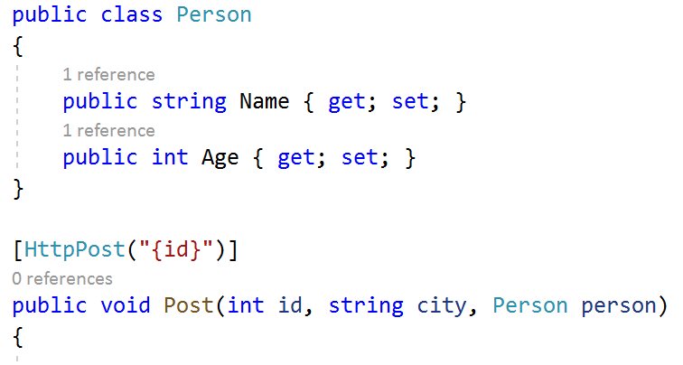
Model Binding
There are three different places in the Request where a client can put data:
So long as the [ApiController] attribute has been used:
Data before the ? in the URL is part of the route
Included in the route template parameter to [HttpPost]
Primitive data types come from the query string by default
The query string is the part that comes after the ? in the URL
Complex data types, e.g. classes, come from the body of the request
POST http://localhost:8602/api/person/12345?city=London HTTP/1.1
Content-Type: application/json
Content-Length: 24
{"Name":"John","Age":36}
Notes:
The [ApiController] attribute is needed to get the behaviour described on this slide. This is desirable, because it ensures that the place the model binder looks for its data corresponds with the most common parts of the request for clients to put that data.
If the [ApiController] attribute has not been used, the default place where the model binder searches for data is different, and it may be necessary to manually set the data source, using the attributes shown on the next slide.

Slide 18
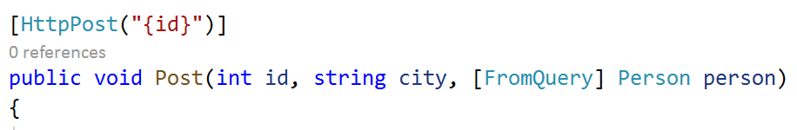
Overriding the Model Source
Attributes can be applied to individual parameters to change their source from the defaults:
[FromBody]
[FromQuery]
[FromRoute]
Note that only a single parameter is allowed to come from the request body
Either one single parameter which comes from the body by default
Or one single parameter with the [FromBody] attribute
POST http://localhost:8602/api/person/12345?city=London&name=John&age=36 HTTP/1.1

Slide 19
More on Data Transfer Objects
We have already seen how DTOs can be used as the return type from Actions
This means that the body of the Response will be a DTO
But you can also use a Data Transfer Object as the parameter types
This means that the body of the Request will be a DTO
Allows you to specify exactly which properties should be included in the Request
As well as ensuring that data you aren’t expecting won’t get bound to the model
Can prevent an “over posting attack”

Slide 20
Testing WebAPI Controllers
When performing integration testing on WebAPI controllers, using a browser is of limited use
You can type a URL into the address bar
A GET request is sent, no option to use any other verbs
No control over request body
The body of the response is shown in the browser
You can access response headers in developer tools in most web browsers
A dedicated tool for testing RESTful APIs is much more useful
One common tool is Postman

Slide 21
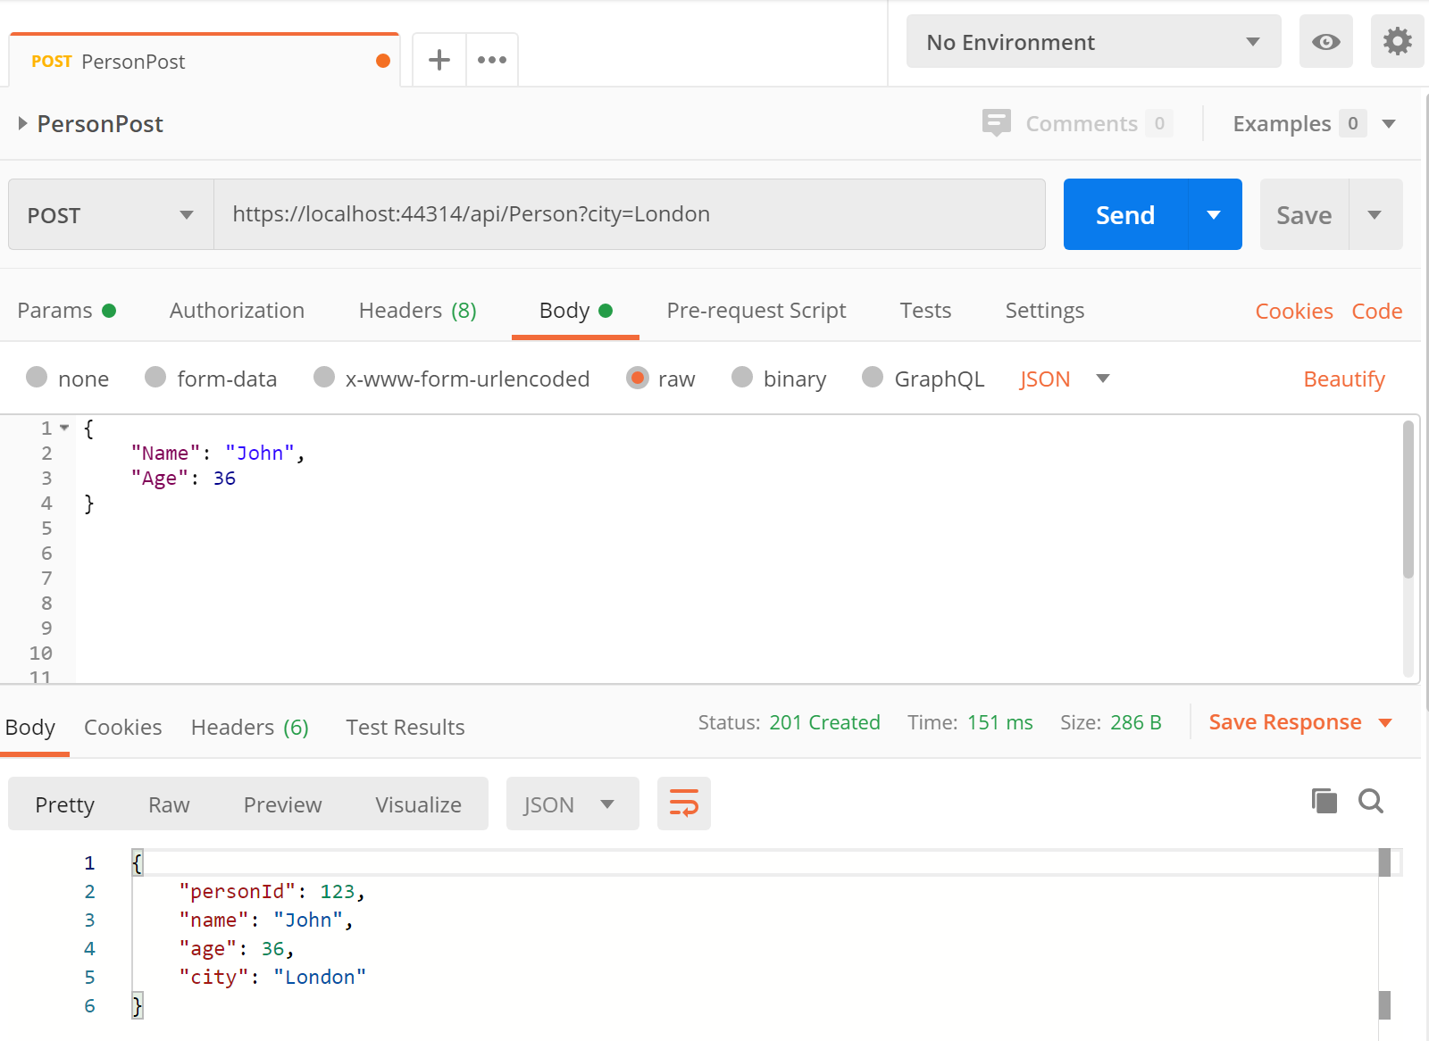
Using Postman to Test WebAPI Controllers
Example Postman screen:
At the top is the verb (POST) and URL
Below that is the Request
Currently showing the request body, which you can change
Can change to see other data e.g. headers, which you can also change
At the bottom is the Response
Currently showing the response body
Can change to see other response data e.g. headers

Slide 22
Documentation and a better testing option?
Open API specification
Set of rules to describe a REST API
Swagger
Set of open-source tools built around the Open API specification
Swashbuckle
Nuget package – Swagger tools for documentation of .NET APIs

Slide 23
What's needed to use Swagger?
Nuget package – Swashbuckle.AspNetCore – has dependencies:-
Swashbuckle.AspNetCore.SwaggerGen
Inspects API code and builds Swagger Document objects automatically
Swashbuckle.AspNetCore.Swagger
Exposes Swagger Document objects as JSON endpoints
Swashbuckle.AspNetCore.SwaggerUI
Generates API documentation and allows testing API calls
Is customisable
Turned on by default when choosing Web API project template in VS

Slide 24
What's needed to use Swagger?
In Program.cs
Add SwaggerGen to services collection
builder.Services.AddSwaggerGen();
Plug in the required middleware
app.UseSwagger();
app.UseSwaggerUI();

Slide 25
What's needed to use Swagger?
Use /swagger/v1/swagger.json to see API description
Use /Swagger to see generated documentation and to test each endpoint
Learn more at https://aka.ms/aspnetcore/swashbuckle

Slide 26
Consuming the API from a client app
Web APIs are designed to be consumed using simple HTTP requests
Therefore the client app just needs to be able to send HTTP requests and deal with HTTP responses
All modern application development frameworks provide this capability out of the box or via a third-party add-in . (See some examples on following slides)

Slide 27
Example from a c# app
HttpClient httpClient = _httpClientFactory.CreateClient();
httpClient.BaseAddress = new Uri("http://localhost:61086");
HttpResponseMessage response = httpClient.GetAsync("http://localhost:61106/api/store/1").Result;
if (response.IsSuccessStatusCode)
{
GroceryStore grocery = await response.Content.ReadAsAsync<GroceryStore>();
return new ObjectResult(grocery);
}
else
{
return Content("An error has occurred");
}

Slide 28
Example from an Angular app
export class AppComponent {
constructor(private http: HttpClient) { }
ngOnInit() {
this.http.get("http://jsonplaceholder.typicode.com/users"). subscribe((data) ⇒ console.log(data))
}
}

Slide 29
Example from a React app
import { useState, useEffect } from 'react';
const App = () => {
const [posts, setPosts] = useState([]);
useEffect(() => {
fetch('https://jsonplaceholder.typicode.com/posts')
.then((res) => res.json())
.then((data) => {
console.log(data);
})
.catch((err) => { console.log(err.message); });
}, []);
return (
// ... consume here
...

Slide 30
Chapter Review
Objectives
Understand the Web API framework
Learn how to create and consume a Web API
Chapter Content
What is Web API
The HTTP Request, Response and Methods
Content Negotiation
Controllers
Data Transfer Objects
Using Postman
Open API/Swagger
Consuming the API
Exercise
Creating and calling Web API Services

Slide 31
Hands On Labs
Creating and Calling WebAPI Services

